Slide 1

Web Server Logs Analytics

Slide 2
Project
Analyze the raw website-logs data and identify the following:
Identify key statistics.
Identify number of users visits
Identify the average session time of users
Identify the commonly used devices
Identify the top referrers to the website

Slide 3
Data Pipe Pine
Log Files
Deduplicte and write to tables
Analysis
Dashboard

Slide 4
Approach
Explore Data
Generate profiling report.
Comprehend data and clean it.
Identification of data variables and its relationships.
Identify missing data and values.
Treat missing data.

Slide 5
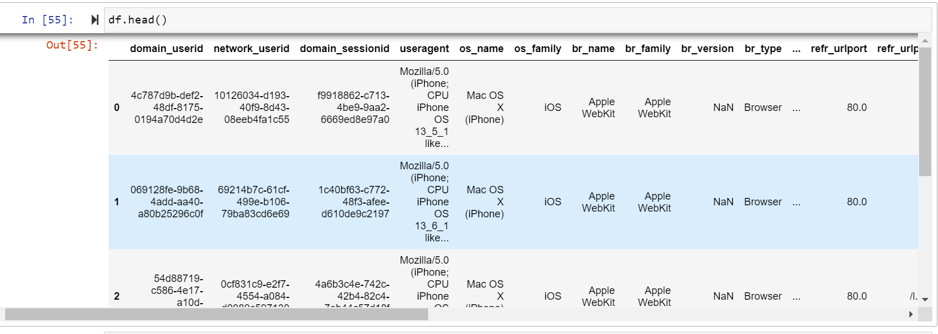
Sample Data

Slide 6
Sample Data

Slide 7
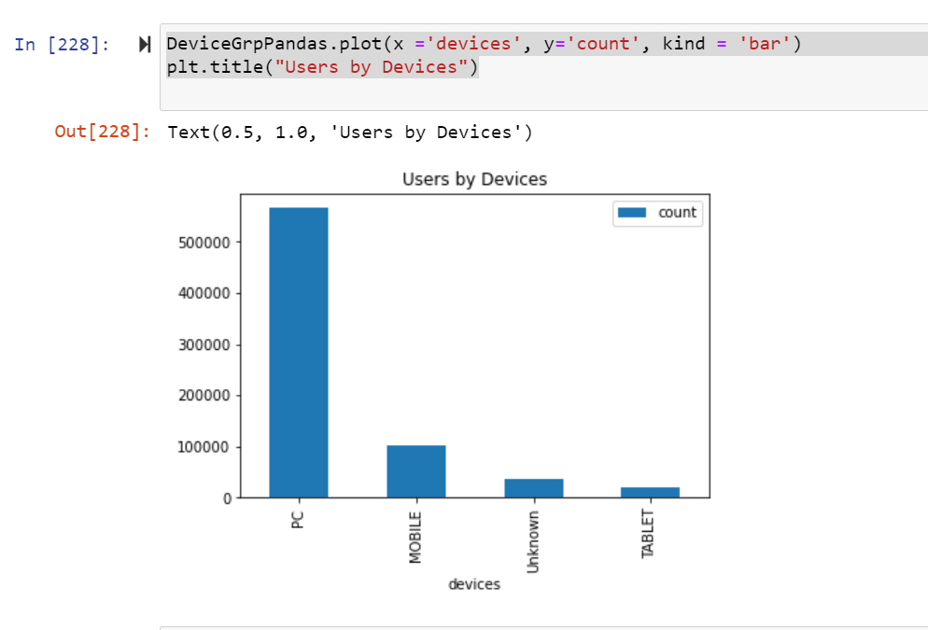
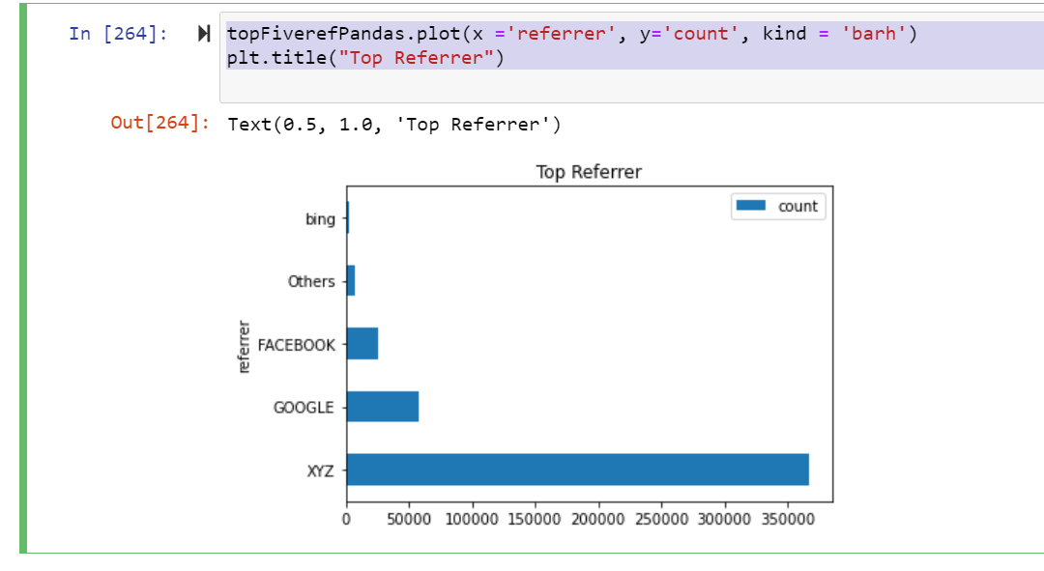
Dashboard Analysis

Slide 8
Thankyou

